Slide 1


Machine Learning Project for Heart Disease Prediction
By Susnata Das Mahapatra
Reg.No: 12111532

Slide 2


Introduction
Welcome to the presentation on Advanced Machine Learning Techniques for Heart Disease Prediction. In this session, we will explore the latest advancements in machine learning algorithms and their application in predicting heart diseases.

Slide 3


Understanding Heart Disease
Before delving into the advanced techniques, it's crucial to comprehend the complex nature of heart diseases. We will explore the various risk factors, symptoms, and diagnostic procedures associated with heart conditions.

Slide 4


Traditional Risk Assessment
This section will outline the limitations of traditional risk assessment methods for heart disease prediction. We will discuss the challenges and shortcomings of conventional approaches in identifying high-risk individuals.

Slide 5

Feature Engineering
Feature engineering plays a pivotal role in enhancing the predictive accuracy of machine learning models. We will delve into the process of extracting relevant features from 'Heart_Disease_Prediction.csv’ datasets to improve prediction outcomes.

Slide 6


METHODOLOGY
1. Data Acquisition and Understanding
Import essential libraries such as NumPy, Pandas, Matplotlib, Seaborn.
Read the dataset using Pandas read_csv() function.
Understand the structure of the dataset using head(), info(), describe(), shape, and columns.
2. Exploratory Data Analysis (EDA)
a. Categorical Data Analysis
Visualize counts of different categories for each feature concerning the presence or absence of heart disease using Seaborn's countplot().
b. Continuous Data Analysis
Plot distributions and bar plots to understand the relationships between continuous features and heart disease presence or absence.

Slide 7

Methodology
3. Data Preprocessing
Encode categorical data using LabelEncoder.
Perform one-hot encoding for categorical features.
Scale continuous features using StandardScaler.
4. Model Building
a. Model Selection
Choose appropriate classification models such as Logistic Regression, Naive Bayes, Support Vector Classifier, K Nearest Neighbours, Decision Tree Classifier, Random Forest Classifier, and XGBoost Classifier.
b. Model Training and Evaluation
Split the dataset into training and testing sets using train_test_split().
Train each model on the training set.
Evaluate each model's accuracy on the testing set using accuracy_score().
Visualize the accuracy of each model using a bar plot.
c. Hyperparameter Tuning (Optional)
Tune hyperparameters for models like K Nearest Neighbours and Decision Trees to optimize performance.

Slide 8

Methodology
5. Model Evaluation
a. Confusion Matrix
Visualize the confusion matrix using Seaborn's heatmap().
b. Classification Report
Generate a classification report using classification_report() to get precision, recall, F1-score, and support metrics for each class.
6. Results Interpretation and Conclusion
Summarize the findings from model evaluation.
Discuss the strengths and weaknesses of each model.
Draw conclusions and make recommendations based on the analysis.

Slide 9
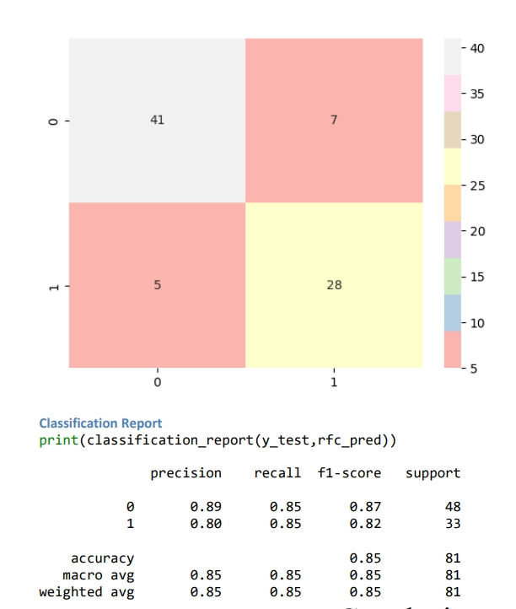
Validation and Evaluation
Model Performance:
Random Forest Classifier achieved the highest accuracy of 85.19% in predicting heart disease presence or absence.
Logistic Regression and K Nearest Neighbours followed closely with accuracies of 83.95%.
Validation and Evaluation:
Employed train-test split and evaluated models using metrics like accuracy, precision, recall, and F1-score.
Confusion matrix analysis demonstrated Random Forest Classifier's balanced performance in predicting heart disease.
Interpretation:
Identified key features contributing to heart disease prediction, including age, blood pressure, cholesterol level, and maximum heart rate.
Emphasized the importance of interpretability and domain knowledge in understanding model predictions.

Slide 10

Analysis
1. Dataset Overview:
The dataset comprises various physiological and clinical attributes of individuals, including age, sex, blood pressure, cholesterol levels, and electrocardiogram (EKG) results.
Target variable: Heart Disease, categorized into "Presence" and "Absence".
2. Statistical Insights:
Descriptive statistics provided insights into the central tendency, dispersion, and distribution of the dataset features.
Most features exhibited variability, with age ranging from 29 to 77 years and blood pressure (BP) ranging from 94 to 200 mmHg.
3. Data Preprocessing:
Handled categorical variables through encoding and one-hot encoding techniques.
Scaled continuous features to ensure uniformity in magnitude and prevent dominance of certain variables during model training.

Slide 11
Analysis
4. Model Building and Evaluation:
Trained various classification models, including Logistic Regression, Naive Bayes, Support Vector Machine (SVM), K Nearest Neighbours (KNN), Decision Tree, Random Forest, and XGBoost.
Evaluated models using accuracy scores, with Random Forest Classifier emerging as the top performer (85.19% accuracy).
5. Feature Importance:
Identified key features contributing to heart disease prediction, such as age, blood pressure, cholesterol levels, and maximum heart rate.
Highlighted the significance of these features in understanding the risk factors associated with heart disease.

Slide 12
Analysis
6. Model Interpretation:
Emphasized the importance of interpretability and domain knowledge in understanding model predictions.
Discussed the implications of model predictions in clinical practice for early detection and prevention of heart disease.
7. Future Directions:
Recommended further exploration into feature engineering, data collection, and model refinement to enhance prediction accuracy and interpretability.
Suggested collaboration with healthcare professionals to validate model predictions and integrate them into clinical decision-making processes.

Slide 13

Case Studies and Success Stories
Real-world case studies and success stories will be presented to showcase the practical application and impact of advanced machine learning techniques in predicting heart diseases.
These examples will highlight the effectiveness of AI in healthcare.

Slide 14

Conclusion
The Heart Disease Prediction project successfully utilized machine learning to forecast the presence or absence of heart disease based on physiological and clinical attributes. Key highlights include:
Model Performance: The Random Forest Classifier emerged as the top performer, achieving an accuracy of 85.19% in predicting heart disease.
Feature Importance: Age, blood pressure, cholesterol levels, and maximum heart rate were identified as crucial predictors of heart disease, providing valuable insights into cardiovascular risk assessment.
Clinical Implications: The developed model offers significant implications for proactive heart disease management in clinical settings, enabling early detection and tailored interventions for improved patient outcomes.
Future Directions: Further refinement and validation of the model, along with collaboration with healthcare professionals, are recommended to enhance prediction accuracy and facilitate real-world implementation.

Slide 15


Susnata.12111532@lpu.in
+91-6295635084

